Slide 1
UNIT-II
Cybercrime: Mobile and Wireless Devices

Slide 2
Introduction
In the recent years, the use of laptops, personal digital assistants (PDAs), and mobile phones has grown from limited user communities to widespread desktop replacement and broad deployment.
The larger and more diverse community of mobile users and their devices increase the demands on the IT function to secure the device, data and connection to the network, keeping control of the corporate assets, while at the same time supporting mobile user productivity.
Proliferation of Mobile and Wireless Devices
A key driver for the growth of mobile technology is the rapid growth of business solutions into hand-held devices.
Mobile computing is “taking a computer and all necessary files and software out into the field.”
Types of mobile computers have been introduced since 1990s are:
1. Portable computer
2. Tablet PC
3. Internet tablet
4. Personal digital assistant (PDA)
5. Ultramobile PC
6. Smartphone
7. Carputer
8. Fly Fusion Pentop computer

Slide 3
Wireless refers to the method of transferring information between a computing device (such as a PDA) and a data source (such as an agency database server) without a physical connection.
Smart hand-helds are defined as hand-held or pocket-sized devices that connect to a wireless or cellular network, and can have software installed on them.
Trends in Mobility
Mobile computing in third generation (3G) promises greater variety in applications and have highly improved usability as well as speedier networking.
This smart mobile technology is rapidly gaining popularity and the attackers (hackers and crackers) are among its biggest fans.
There are numerous attacks that can be committed against mobile networks and they can originate from two primary vectors.
One is from outside the mobile network – public Internet, private networks and other operator’s networks
The other is within the mobile networks – devices such as data-capable handsets and Smartphones, notebook computers or even desktop computers connected to the 3G network.

Slide 4
Popular types of attacks against 3G mobile networks are as follows:
Malwares, viruses and worms
Denial-of-service (DoS)
Overbilling attack
Spoofed policy development process (PDP)
Signaling-level attacks
Credit Card Frauds in Mobile and Wireless Computing Era
Wireless credit card processing is a relatively new service that will allow a person to process credit cards electronically, virtually anywhere.
it allows businesses to process transactions from mobile locations quickly, efficiently and professionally.
It is most often used by businesses that operate mainly in a mobile environment.
Some upscale restaurants are using wireless processing equipment for the security of their credit card paying customers.
Figure 1 shows the basic flow of transactions involved in purchases done using credit cards.

Slide 5
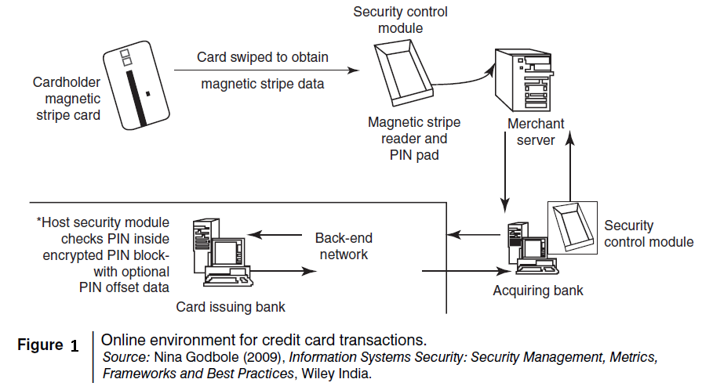

Slide 6
Types and Techniques of Credit Card Frauds
Traditional Techniques
Paper-based fraud – wherein a criminal uses stolen or fake documents such as utility bills and bank statements that can build up useful personally Identifiable Information (PII) to open an account in someone else’s name.
Application fraud
1. ID theft: Where an individual pretends to be someone else.
2. Financial fraud: Where an individual gives false information about his or her financial status to acquire credit.
Modern Techniques
Skimming to commit fraud - the information held on either the magnetic strip on the back of the credit card or the data stored on the smart chip are copied from one card to another.
Site cloning and false merchant sites on the Internet - designed to get people to hand over their credit card details.
Security Challenges Posed by Mobile Devices
Some well-known technical challenges in mobile security are
managing the registry settings and configurations
authentication service security, cryptography security
Lightweight Directory Access Protocol (LDAP) security
remote access server (RAS ) security
media player control security
networking application program interface (API ) security

Slide 7
Registry Settings for Mobile Devices
Microsoft ActiveSync acts as the gateway between Windows-powered PC and Windows mobile-powered device, enabling the transfer of applications such as Outlook information, Microsoft Office documents, pictures, music, videos and applications from a user’s desktop to his/her device.
It can synchronize directly with the Microsoft exchange server so that the users can keep their E-Mails, calendar, notes and contacts updated wirelessly when they are away from their PCs.
Establishing trusted groups through appropriate registry settings becomes crucial.
One of the most prevalent areas where this attention to security is applicable is within “group policy.”
The emphasis on most of the group policy settings is security.
New mobile applications are constantly being provided to help protect against Spyware, viruses, worms, malware and other Malicious Codes that run through the networks and the Internet.
The core problem to many of the mobile security issues on a Windows platform is that the baseline security is not configured properly.
Figure 2 displays an illustration of how some tools allow users to browse to the desired registry value on their mobile devices.

Slide 8
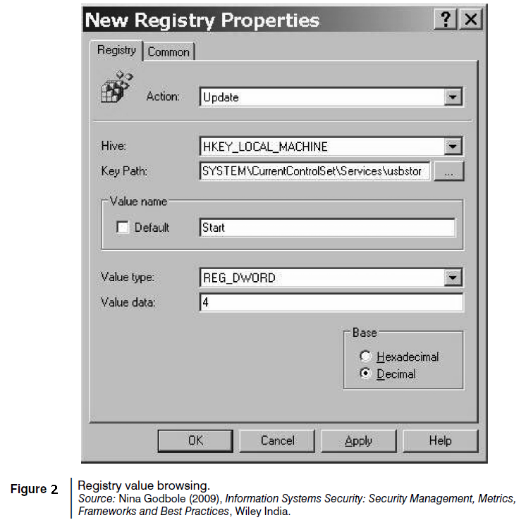

Slide 9
Authentication Service Security
There are two components of security in mobile computing
security of devices
security in networks.
A secure network access involves mutual authentication between the device and the base stations or Web servers.
Authentication services security is important given the typical attacks on mobile devices through wireless networks: DoS attacks, traffic analysis, eavesdropping, man-in-the-middle attacks and session hijacking.
Security measures in this scenario come from Wireless Application Protocols (WAPs), use of VPNs, media access control (MAC ) address filtering and development in 802.xx standards.
Cryptographic Security for Mobile Devices
Cryptographically generated addresses (CGA) is Internet Protocol version 6 (IPv6) that addresses up to 64 address bits that are generated by hashing owner’s public-key address.
The address the owner uses is the corresponding private key to assert address ownership and to sign messages sent from the address without a public-key infrastructure (PKI) or other security infrastructure.
Deployment of PKI provides many benefits for users to secure their financial transactions initiated from mobile devices.

Slide 10
LDAP Security for Hand-Held Mobile Computing Devices
LDAP is a software protocol for enabling anyone to locate individuals, organizations and other resources such as files and devices on the network.
It is a light weight version of Directory Access Protocol (DAP) because it does not include security features in its initial version.
RAS Security for Mobile Devices
RAS is an important consideration for protecting the business-sensitive data that may reside on the employees’ mobile devices.
Impersonating or masquerading - By using a mobile device to appear as a registered user to these systems, a would-be cracker is then able to steal data or compromise corporate systems in other ways.
Port scanning - First, attackers use a domain name system (DNS) server to locate the IP address of a connected computer. Second, they scan the ports on this known IP address, working their way through its Transmission Control Protocol (TCP)/User Datagram Protocol (UDP) stack to see what communication ports are unprotected by firewalls.
A personal firewall on a pocket PC or Smartphone device can be an effective protective screen against this form of attack for the users connecting through a direct Internet or RAS connection.

Slide 11
Media Player Control Security
Media player can turn out to be a source of threat to information held on mobile devices.
In the most severe exploit of a flaw, a hacker could take over a computer system and perform any task the computer’s owner is allowed to do, such as opening files or accessing certain parts of a network.
In the registry, there are some keys which control the behavior of the Windows Media Player control. Microsoft, through its developer network MSDN, describes details of registry value settings on the mobile devices.
Networking API Security for Mobile Computing Applications
With E-Commerce and M-Commerce, online payments are becoming a common phenomenon with the payment gateways accessed remotely and possibly wirelessly.
With Web services and their use in mobile computing applications, the API becomes an important consideration.
Most of these developments are targeted specifically at securing a range of embedded and consumer products, including those running OSs such as Linux, Symbian, Microsoft Windows CE and Microsoft Windows.
Providing a common software framework, APIs will become an important enabler of new and higher value services.

Slide 12
Attacks on Mobile/Cell Phones
Mobile phone Theft
Mobile Viruses
Mobile viruses get spread through two dominant communication protocols – Bluetooth and MMS.
Bluetooth virus can easily spread within a distance of 10–30 m, through Bluetooth-activated phones.
MMS virus can send a copy of itself to all mobile users whose numbers are available in the infected mobile phone’s address book.
How to Protect from Mobile Malwares Attacks
Following are some tips to protect mobile from mobile malware attacks:
1. Download or accept programs and content only from a trusted source.
2. If a mobile is equipped with Bluetooth, turn it OFF or set it to non-discoverable mode when it is not in use and/or not required to use.
3. If a mobile is equipped with beam (i.e., IR), allow it to receive incoming beams, only from the trusted source.
4. Download and install antivirus software for mobile devices.

Slide 13
Mishing
Mishing is Phishing related to mobile phone and Phishing
If you use your mobile phone for purchasing goods/services and for banking, you could be more vulnerable to a Mishing scam.
Attacker will pretend to be an employee from your bank or another organization and will claim a need for your personal details.
Vishing
Vishing is Phishing over the telephone system, most often using features facilitated by VoIP, to gain access to personal and financial information from the public for the purpose of financial reward. It include:
1. ID theft;
2. purchasing luxury goods and services;
3. transferring money/funds;
4. monitoring the victims’ bank accounts;
5. making applications for loans and credit cards.
Smishing
Smishing is SMS PhISHING.
Smishing uses cell phone text messages to deliver a lure message to get the victim to reveal his/her PI.

Slide 14
Hacking Bluetooth
Bluetooth is a short-range wireless communication service/technology that uses the 2.4-GHz frequency range for its transmission/communication.
An attacker installs special software on a laptop and then installs a Bluetooth antenna which constantly scans the nearby surroundings for active Bluetooth connections.
Once the software tool used by the attacker finds and connects to a vulnerable Bluetooth-enabled cell phone, it can like download address book information, photos, calendars, SIM card details, make long-distance phone calls using the hacked device, bug phone calls and much more.
Some bluetooth-specific security issues are:
Bluejacking
Bluesnarfing
3. Bluebugging
4. Car Whisperer

Slide 15
Unconventional/Stealth Storage Devices
Firewalls and antivirus software are no defense against the threat of open USB ports.
Not only can viruses, worms and Trojans get into the organization network, but can also destroy valuable data in the organization network.
Sometimes the standard access controls with Windows OS do not allow the assignment of permissions for USB ports and restricting these devices becomes next to impossible.
Anyone can connect a USB/small digital camera/MP3 player to the USB port of any unattended computer and will be able to download confidential data or upload harmful viruses
Another factor in cybersecurity complications with mobile devices is their falling cost.
Early hand-helds were expensive and specialized, so they were deployed only for specific applications, but more general-purpose models are now available at a relatively low cost, often bundled with a tariff for wireless connection.
Because modern hand-held devices for mobile computing are, at times, good productivity tools, they cannot be precluded from use by employees, contractors and other business entities.
It is important for the device management teams to include user awareness education; thus, they get encouraged to take some personal responsibility for the physical security of their devices.

Slide 16
Threats through Lost and Stolen Devices
Often mobile hand-held devices are lost while people are on the move.
It is often not the value of the hand-held device that is important but rather the content that, if lost or stolen, can put a company at a serious risk of sabotage, exploitation or damage to its professional integrity, as most of the times the mobile hand-held devices are provided by the organization.
Protecting Data on Lost Devices
For protecting data that are stored persistently on a device, there are two precautions that individuals can take to prevent disclosure of the data stored on a mobile device:
encrypting sensitive data
encrypting the entire files system
Data that are stored on hard disks in persistent memory or on removable memory sticks should be protected by encrypting the servers where a database files is residing.
Educating the Laptop Users
Often it so happens that corporate laptop users could be putting their company’s networks at risk by downloading non-work-related software capable of spreading viruses and Spyware, result from a survey is quoted in Fig. 3 confirms this.
The policies and procedures put in place for support of laptop have evolved over the years to be able to cope successfully with managing laptops, connected by wireless means or otherwise.

Slide 17
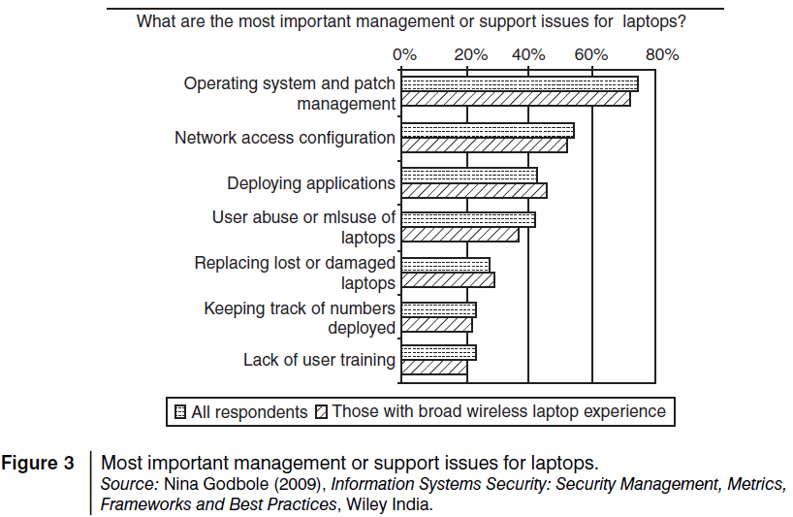

Slide 18
Encrypting Organizational Databases
To protect the organizations’ data loss, databases need encryption.
Two algorithms that are typically used to implement strong encryption of database files are:
Rijndael, a block encryption algorithm, chosen as the new Advanced Encryption Standard (AES) for block ciphers by the National Institute of Standards and Technology (NIST).
Multi-Dimensional Space Rotation (MDSR) algorithm developed by Casio.
Encrypting the database scrambles the information contained in the main database file so that it cannot be deciphered by looking at the files using a disk utility.
When using strong encryption, it is important not to store the key on the mobile device: this is equivalent to leaving a key in a locked door.
The key is required whenever you want to start the database or you want to use a utility on your database.
For greater security there is an option available that instructs the database server to display a dialog box where the user can enter the encryption key.
Including Mobile Devices in Security Strategy
A few things that enterprises can use are:
Implement strong asset management, virus checking, loss prevention and other controls for mobile systems that will prohibit unauthorized access and the entry of corrupted data.
2. Investigate alternatives that allow a secure access to the company information through a firewall, such as mobile VPNs.
3. Develop a system of more frequent and thorough security audits for mobile devices.
4. Incorporate security awareness into your mobile training and support programs.
5. Notify the appropriate law-enforcement agency and change passwords.

Slide 19
Importance of Security Policies relating to Mobile Computing Devices
One should think about not to keep credit card and bank account numbers, passwords, confidential E-Mails and strategic information about organization, merger or takeover plans and also other valuable information that could impact stock values in the mobile devices.
One should give a deep thought about the potential legal troubles for a public company whose sales reports, employee records or expansion plans may fall into wrong hands.
When controls cannot be implemented to protect data in the event they are stolen, the simplest solution is to prevent users from storing proprietary information on platforms deemed to be insufficiently secure.
Organizational Policies for the Use of Mobile Hand-Held Devices
The first step in securing mobile devices is creating company policies that address the unique issues these devices raise.
There are many ways to handle the matter of creating policy for mobile devices:
Creating a distinct mobile computing policy.
Including such devices under existing policy.
In a hybrid approach, a new policy is created to address the specific needs of the mobile devices.
“acceptable use” policy for other technologies is extended to the mobile devices.
There may not be a need for separate policies for wireless, LAN, wide area network (WAN), etc. because a properly written network policy can cover all connections to the company data, including mobile and wireless.

Slide 20
Laptops
Laptops pose a large threat as they are portable.
Wireless capability in these devices has also raised cybersecurity concerns owing to the information being transmitted over other, which makes it hard to detect.
Cybercriminals are targeting laptops that are expensive, to enable them to fetch a quick profit in the black market.
Physical Security Countermeasures
Physical security countermeasures are becoming very vital to protect the information on the employees’ laptops and to reduce the likelihood that employees will lose laptops.
A few logical access controls are as follows:
1. Protecting from malicious programs/attackers/social engineering.
2. Avoiding weak passwords/open access.
3. Monitoring application security and scanning for vulnerabilities.
4. Ensuring that unencrypted data/unprotected file systems do not pose threats.
5. Proper handling of removable drives/storage mediums/unnecessary ports.
6. Password protection through appropriate passwords rules and use of strong passwords.
7. Locking down unwanted ports/devices.
8. Regularly installing security patches and updates.
9. Installing antivirus software/firewalls/intrusion detection system (IDSs).
10. Encrypting critical file systems.
11. Other countermeasures:
• Choosing a secure OS.
• Registering the laptop with the laptop manufacturer.
• Disabling unnecessary user accounts and renaming the administrator account.
• Disabling display of the last logged in username in the login dialog box.
• Backing up data on a regular basis.

